Slide 1
Basic CNN

Slide 2
Fully Connected Network
From 2D to 1D
Lose spatial features
Too many network parameters
Hard to train

Slide 3
Keep the 2D features
2D Image input
Convolve input with kernels
Feature maps as learnable parameters
Reduce size
Less parameters and easier to train

Slide 4

CNN
http://parse.ele.tue.nl/cluster/2/CNNArchitecture.jpg

Slide 5
CNN Layers
Convolution
Non-Linear(Relu for example
Pooling or sub sampling( Max Pooling for example)
Classification (Full connected)

Slide 6
Convolutional Layers

Slide 7
Input Image, Kernel(Filter),
Feature Map(Output Volume)

Slide 8
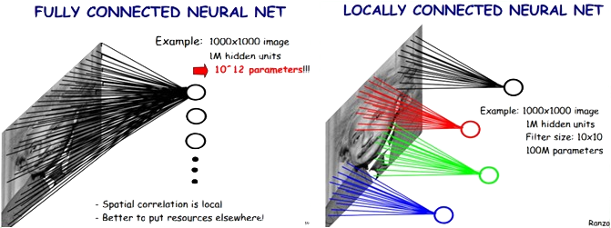
Locally Connected Features

Slide 9

An Image is a 2D matrix

Slide 10
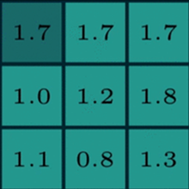

Two maxtrics interact
Reception field
A kernel(filter, neuron)
Numbers: weights

Slide 11
Two maxtrics interact
Sliding

Slide 12
Two maxtrics interact

Slide 13
Two maxtrics interact

Slide 14

Kernel(Filter)
255
200
0
*
=
155
55
35
???
55
10
5

Slide 15
Two maxtrics interact

Slide 16
Two maxtrics interact

Slide 17
Two maxtrics interact

Slide 18

Generate a new image
32 X 32 X 3
3x3x3
Feature Map
(Activation Map)
(Output Volume)
30 X 30 X 3

Slide 19

Generate a new image

Slide 20
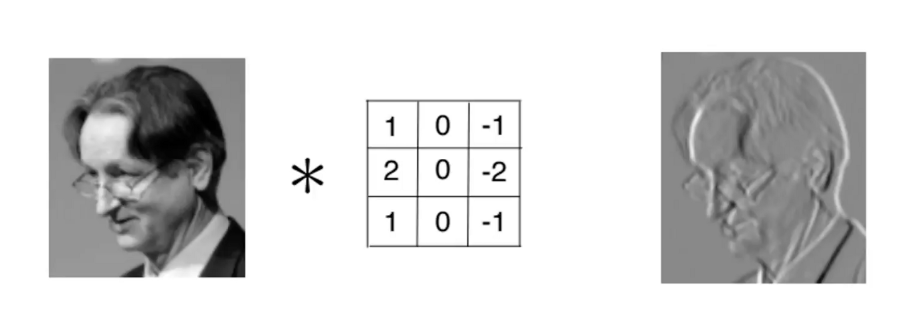
Kernel is used as Feature Detector

Slide 21
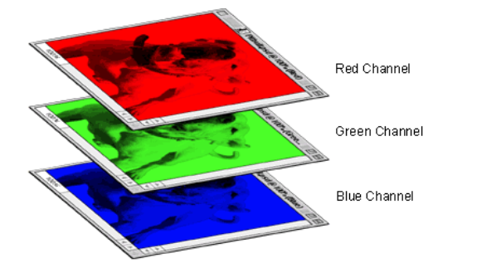
A colored image is 3 x 2d matrix

Slide 22
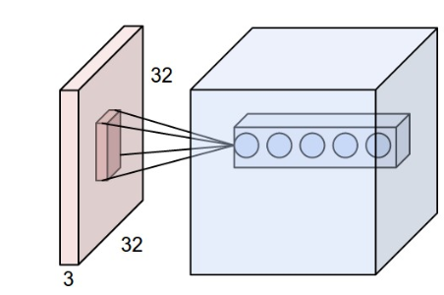
Convolve in 3D(32x32x3) Input Image
Every kernel should be (mxmx3) size
The kernel slide over the xy plane with same depth(3)
The product of 3D image and 3D kernel is still a 2D plane.
The output volume is the stack of all planes created by all kernels.
In this example the output volume is nxnx5 dimension.

Slide 23
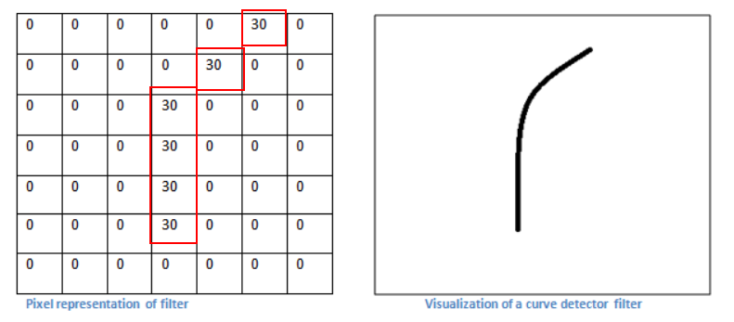
A filter is just a feature identifier

Slide 24
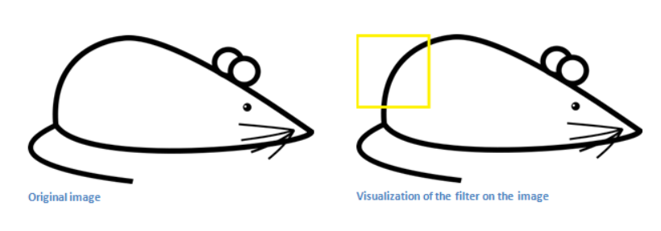
Filter on a part of an image

Slide 25
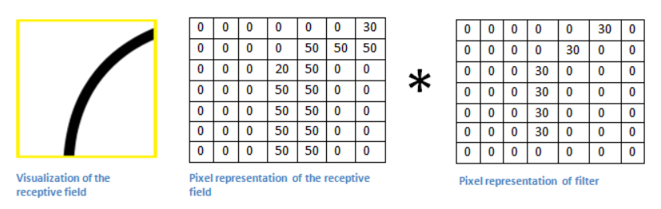
Just matrics multiplication

Slide 26
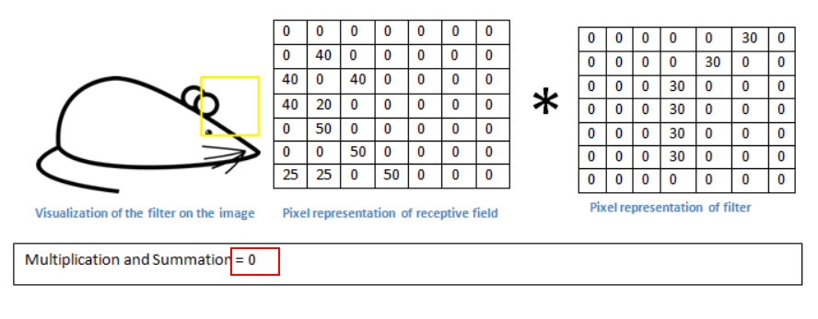
Without the feature

Slide 27
Filters = Feature Detectors
A filter for a unique feature.
Millions of filters in a convolutional network
Higher number ‘fires’ means the feature is detected
So many different feature detectors for different features.

Slide 28
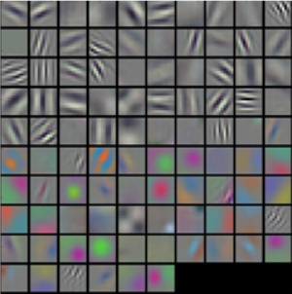
Filters = Feature Detectors

Slide 29
Layers that extract features
Earlier layers extract low level object like curves and edges.
We need the network to recognize higher level features such as hands, or paws or ears.
Different neurons in each layer is representing a feature to detect different objects, like faces, texts.

Slide 30
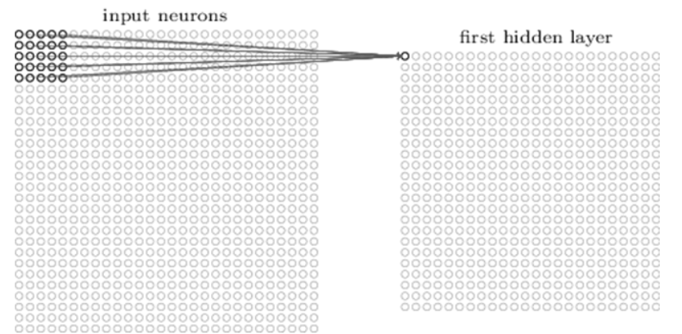
A first layer neuron:
The number of weights is 5x5x1(Kernel dimension ) + 1 bias.

Slide 31
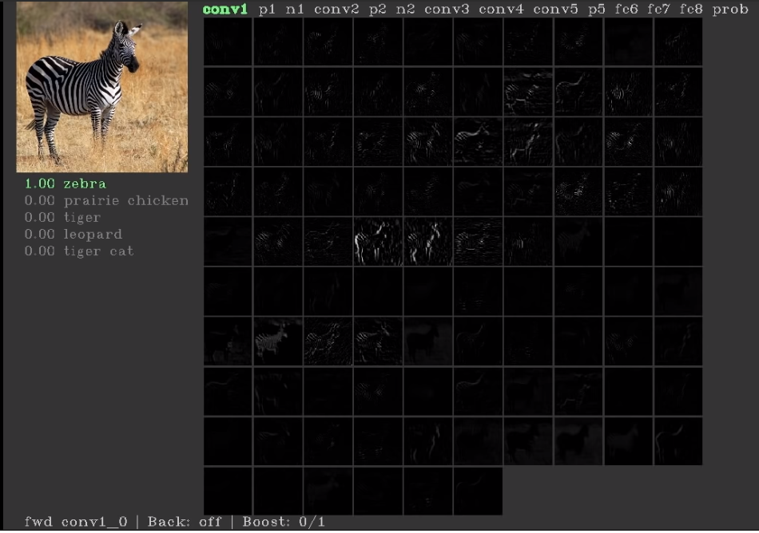
First layers’ neurons for basic features(conv1)

Slide 32
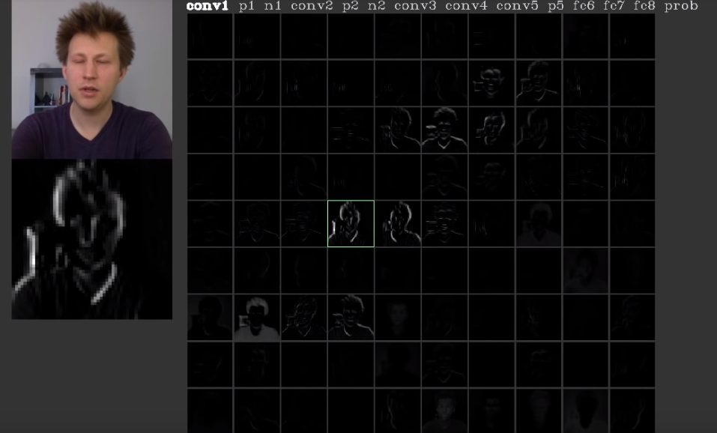
First layers’ neurons for basic features(conv1)

Slide 33
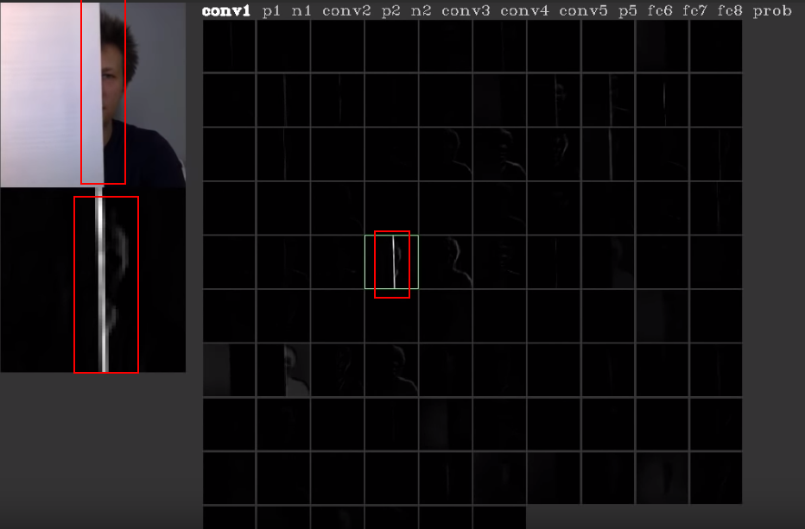
The neuron is for edges

Slide 34
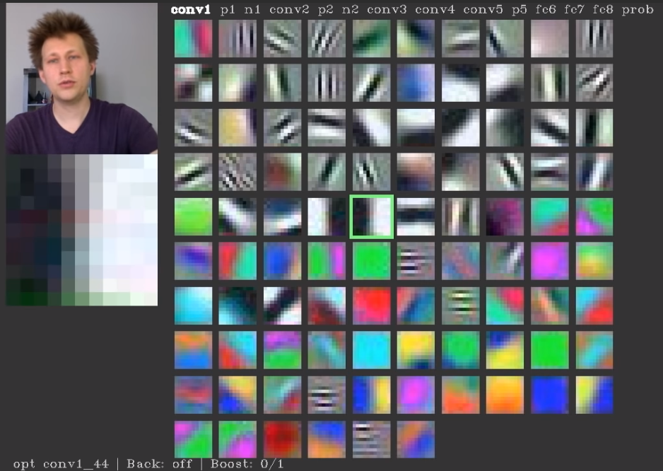
Every neuron is looking for something

Slide 35
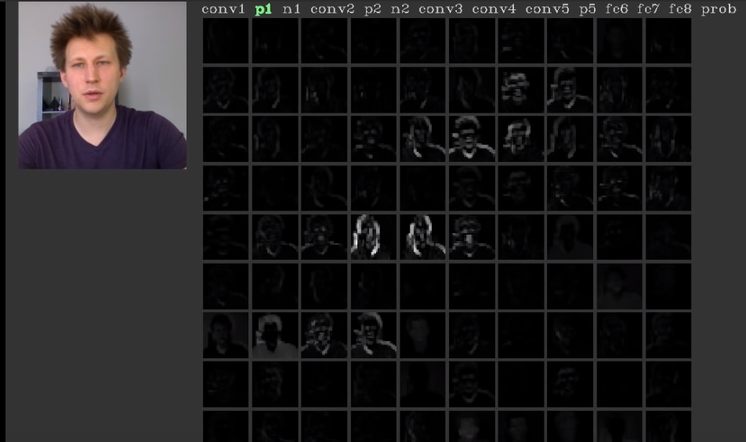
Pooling layer

Slide 36
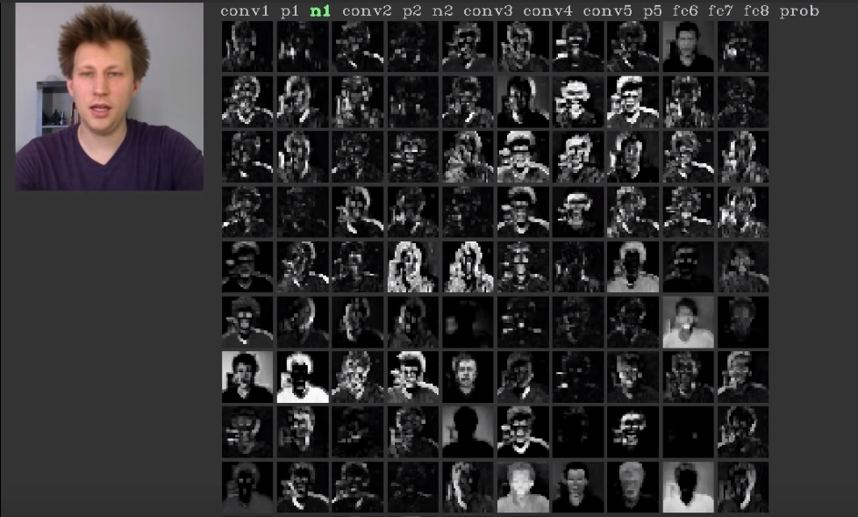
Normalise layer

Slide 37
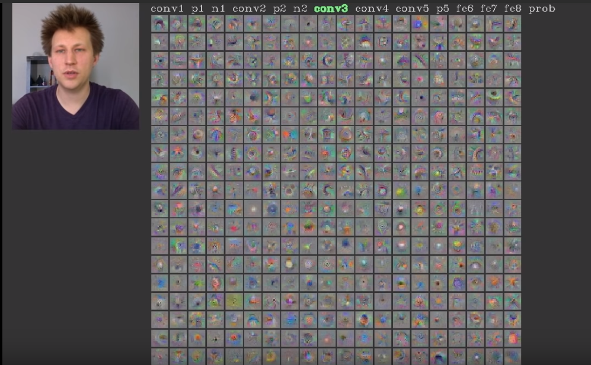
Con3 layer

Slide 38
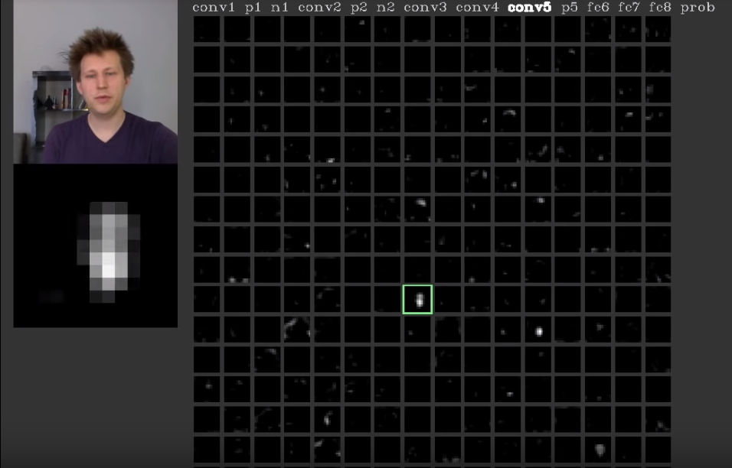
Neuron in con5 layer is for faces

Slide 39
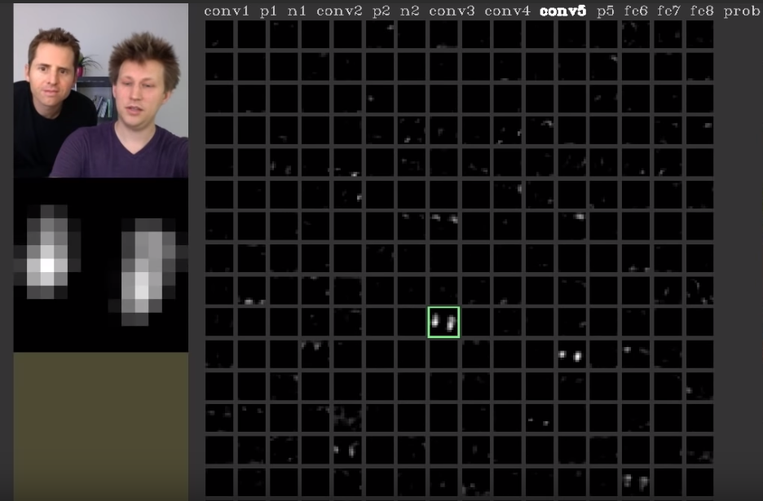
Neuron in con5 layer is for faces

Slide 40
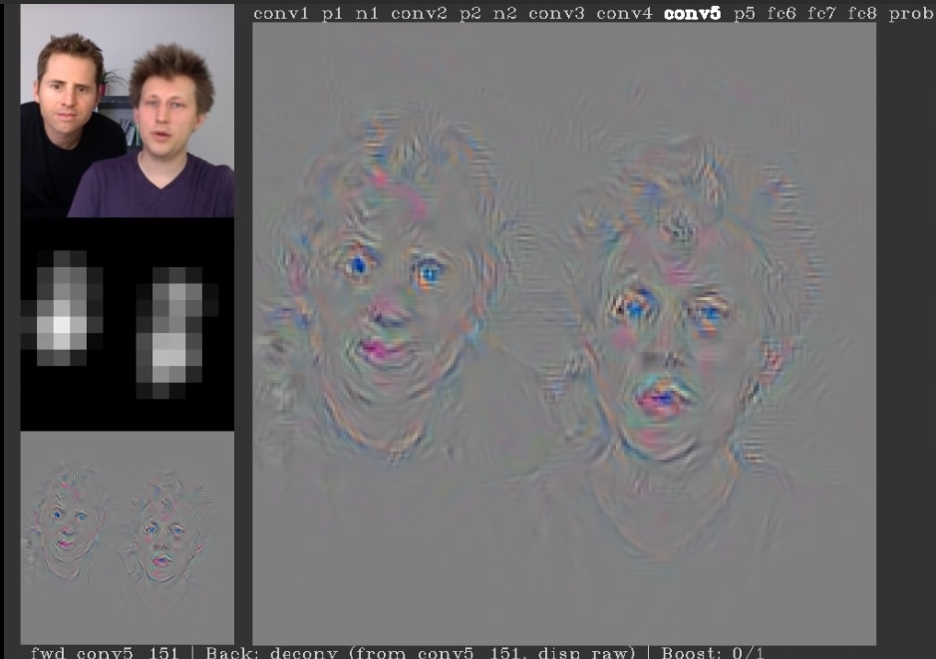
Neuron in con5 layer is for faces

Slide 41
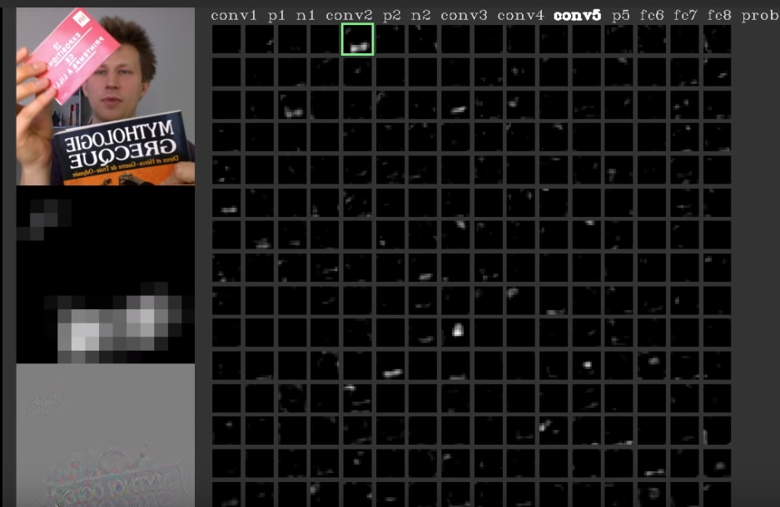
Neuron in con5 layer is for printed texts

Slide 42
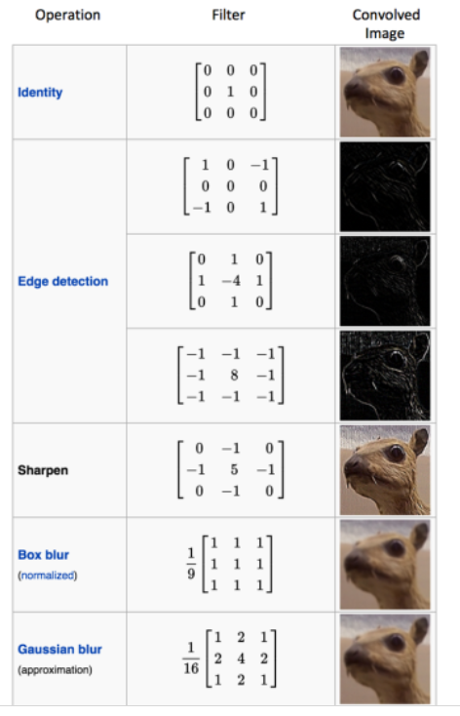
Different filters can detect different features from an image

Slide 43
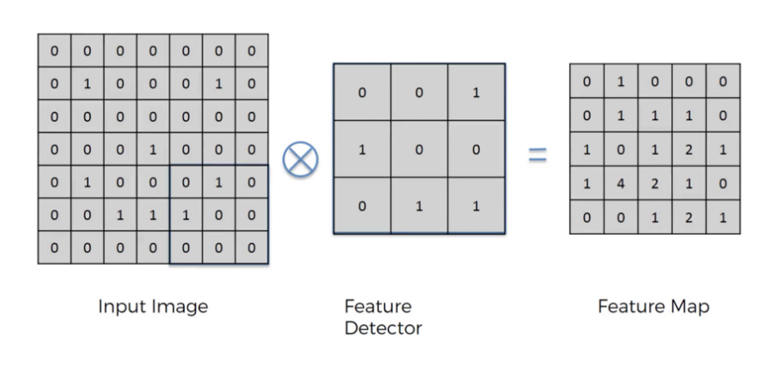
Convolution

Slide 44
Convolution
Convolution is a mathematical operation on two functions
To produce a third function that expresses how the shape of one is modified by the other.
The term convolution refers to both the result function and to the process of computing it. Convolution is similar to cross-correlation
Convolution preserves the spatial relationship between pixels by learning image features using small squares of input data.

Slide 45
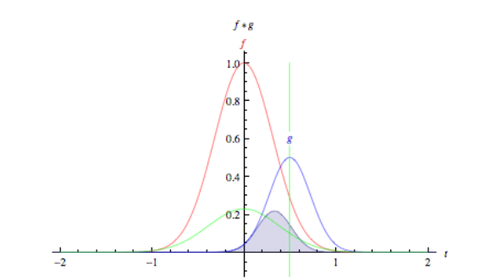
Convolution

Slide 46

Convolution

Slide 47

Two images convolve

Slide 48
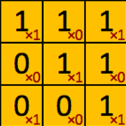
filter‘ or ‘kernel’ or ‘feature detector

Slide 49
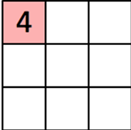
Convolved Feature’ or ‘Activation Map’ or the ‘Feature Map‘

Slide 50

Convolution operation captures the local dependencies in the original image

Slide 51
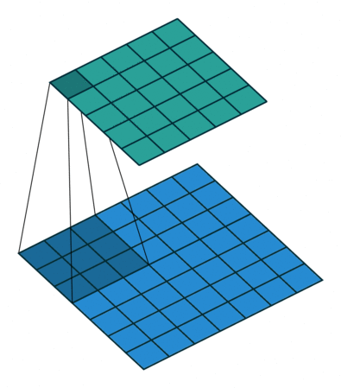
Convolution in Action

Slide 52
Relu Layers

Slide 53
Relu Layers
Added after every convolutional layer.
As non-linear layer(activation layer)
Since all conv layers are doing linear computing.
Used to use tanh and sigmoid.
Relu is faster.
f(x) = max(0, x)

Slide 54
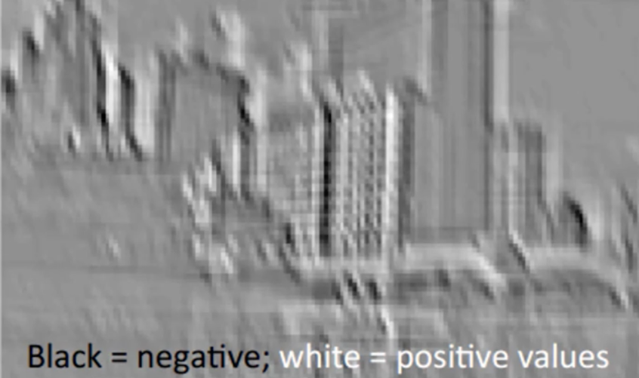
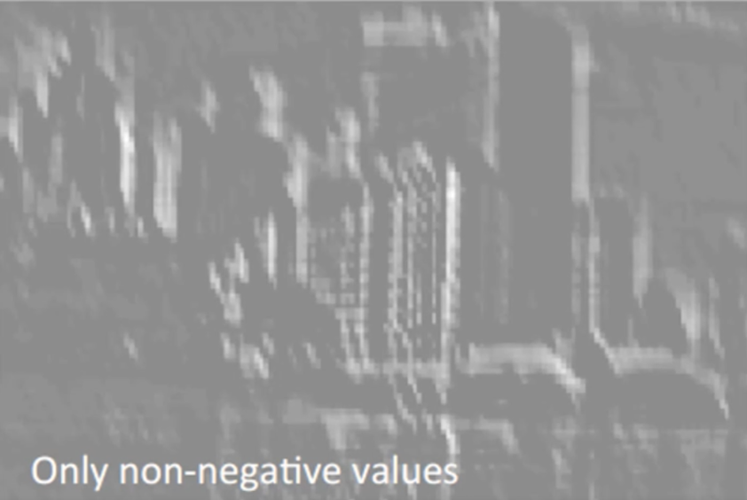
Relu, delete negative(black)

Slide 55
Size of featured map
Depth
Stride
Zero-padding
https://github.com/vdumoulin/conv_arithmetic

Slide 56
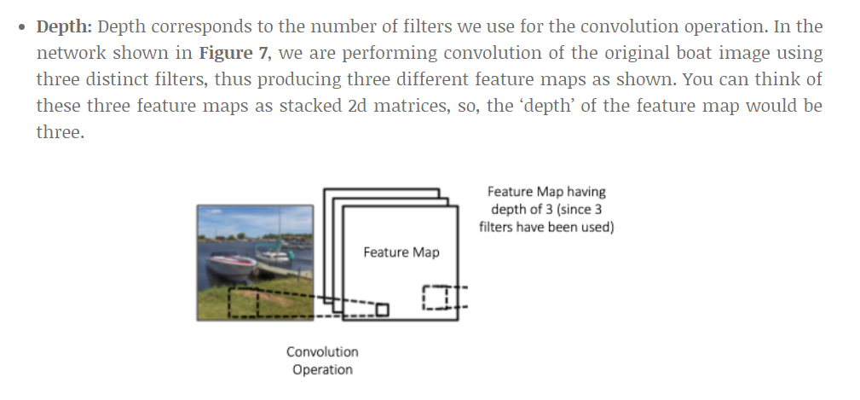
Depth(Number of filters)
https://github.com/vdumoulin/conv_arithmetic

Slide 57
Stride
How many cell we move the kernel.
Bigger stride, smaller output image.
Usually less than 3.

Slide 58
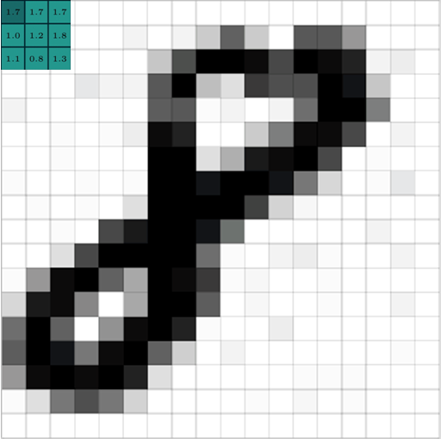
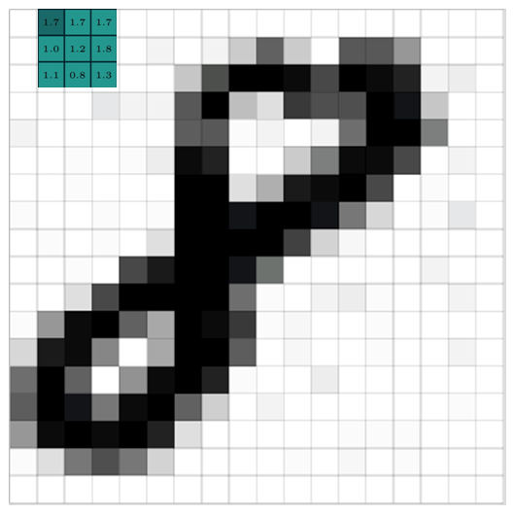
Stride = 1

Slide 59
Stride = 2

Slide 60
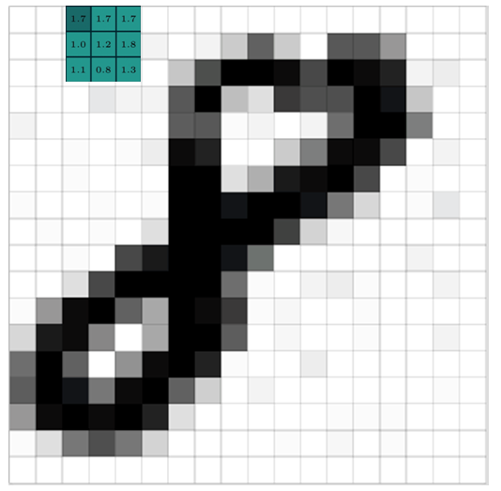
Stride = 2

Slide 61
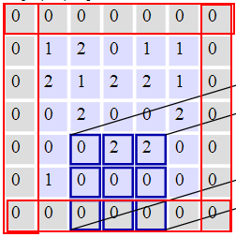
Zero Padding
Pad cells around a map
Could be any size
Usually 0-2
Purpose is to keep the output map the same dimension as input map.

Slide 62
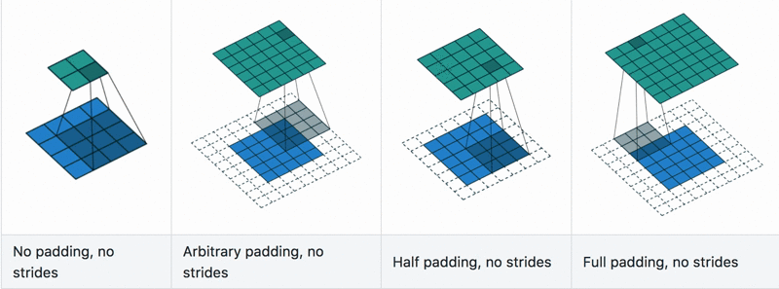
Convolution with padding in Action
https://github.com/vdumoulin/conv_arithmetic

Slide 63
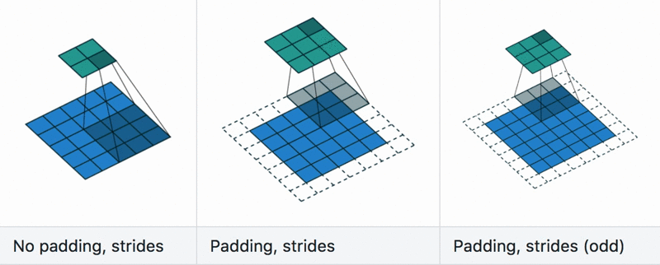
Convolution with stride+padding in Action
https://github.com/vdumoulin/conv_arithmetic

Slide 64
Convolve in action

Slide 65
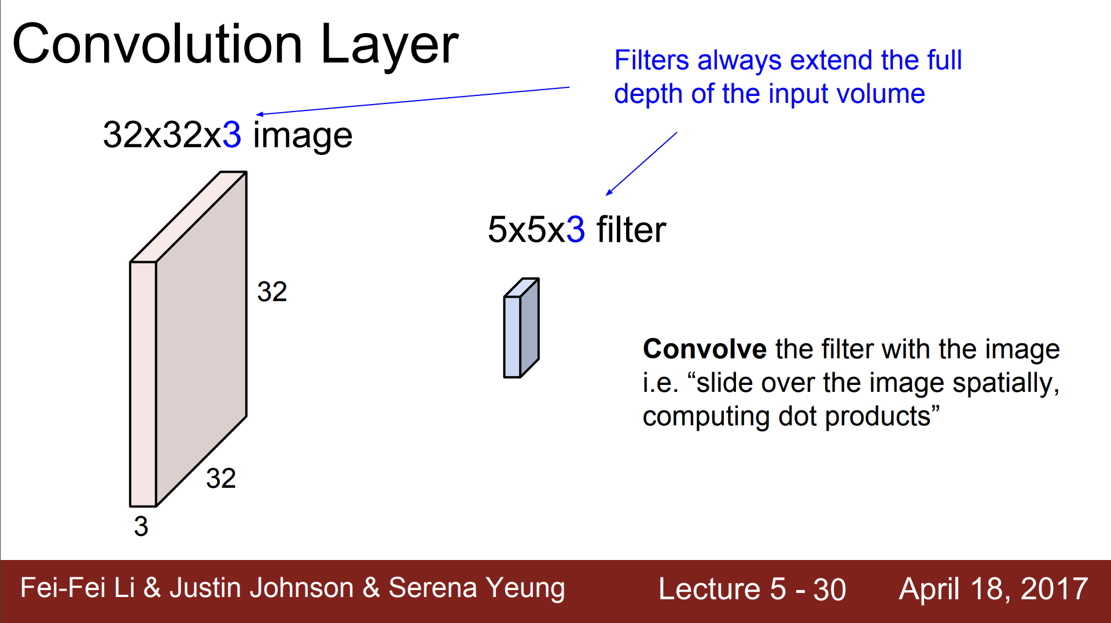

Slide 66
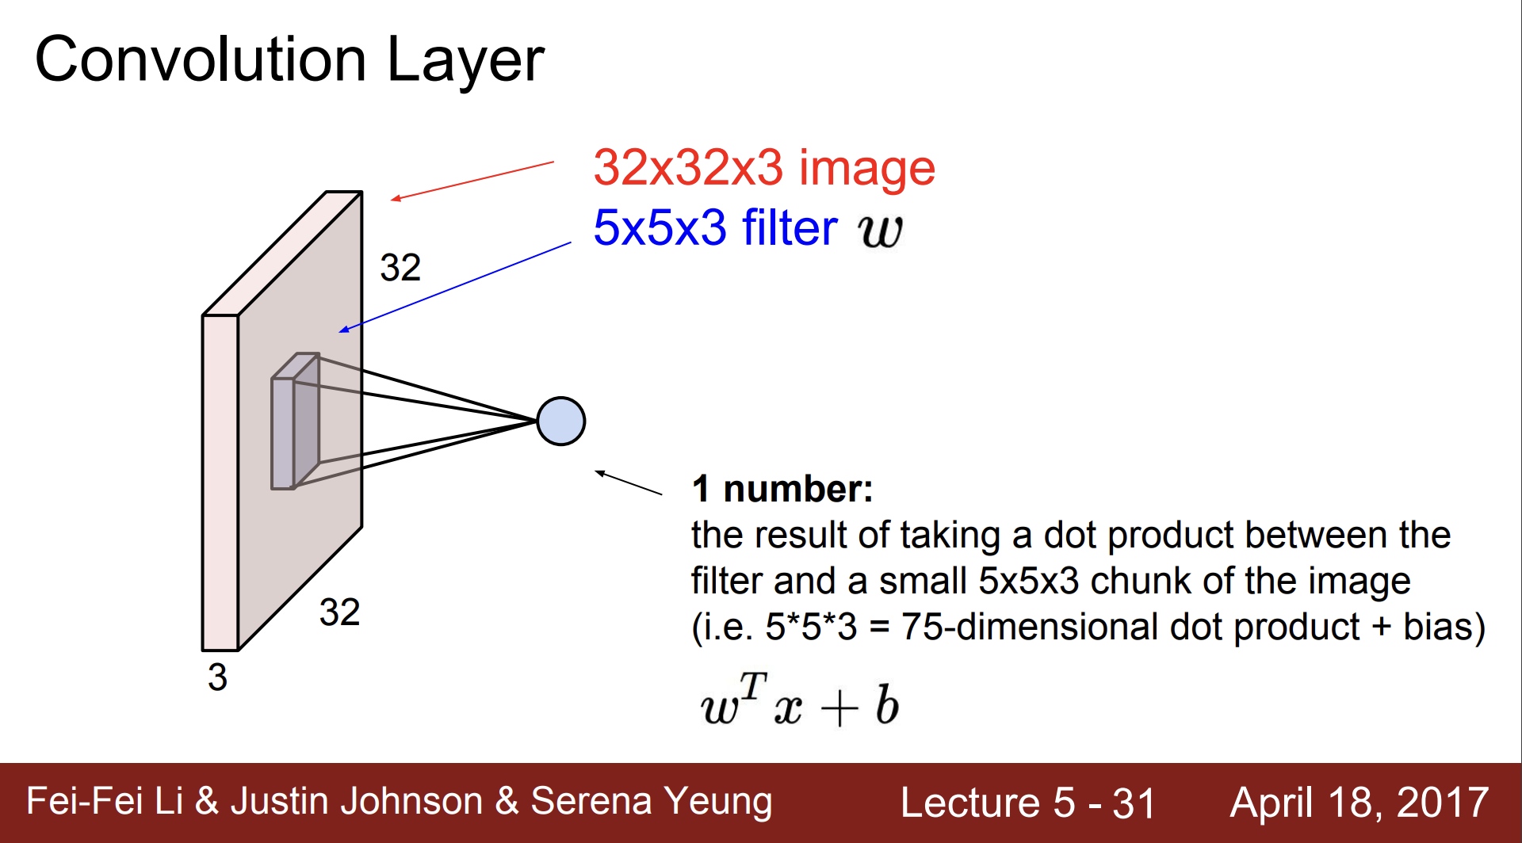

Slide 67
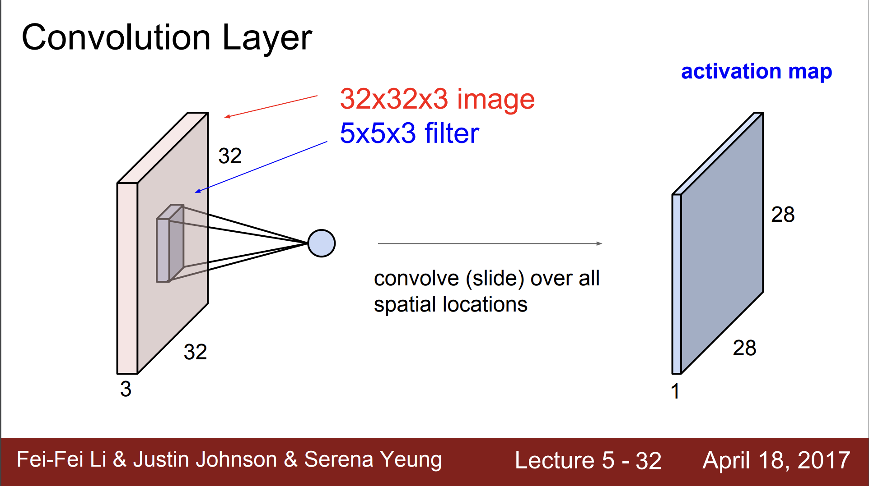

Slide 68
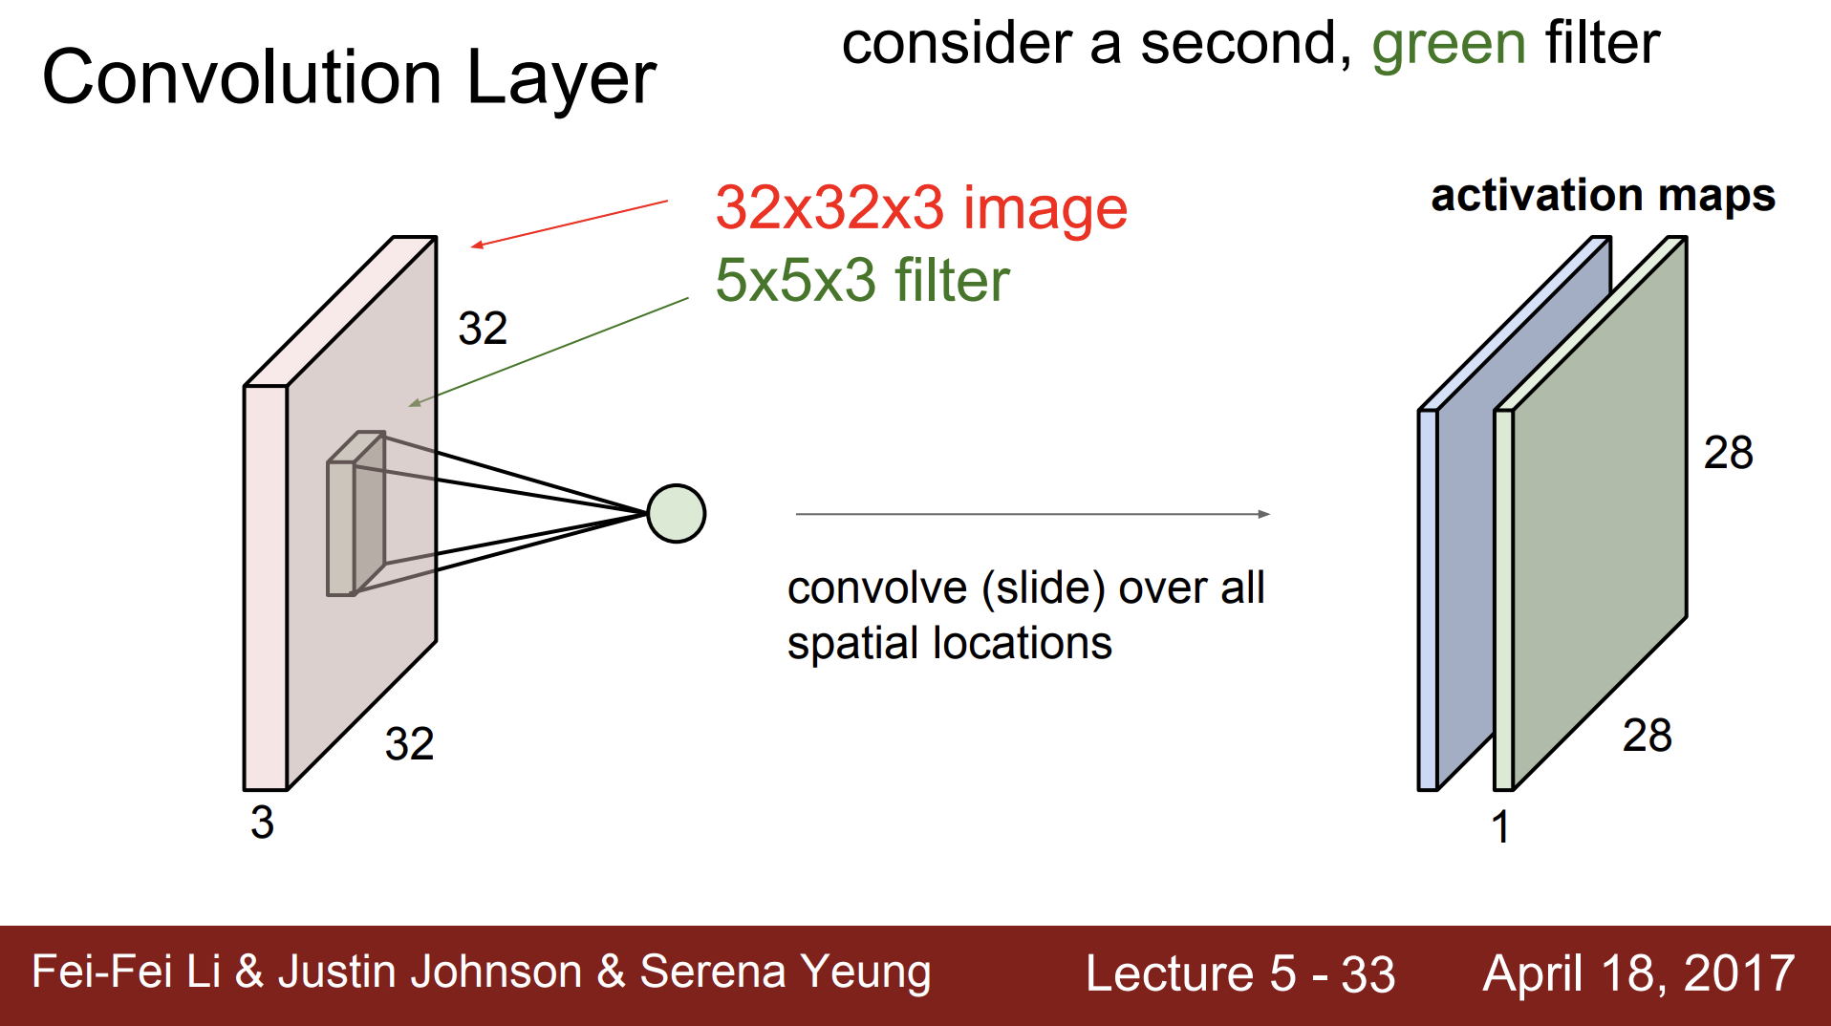

Slide 69
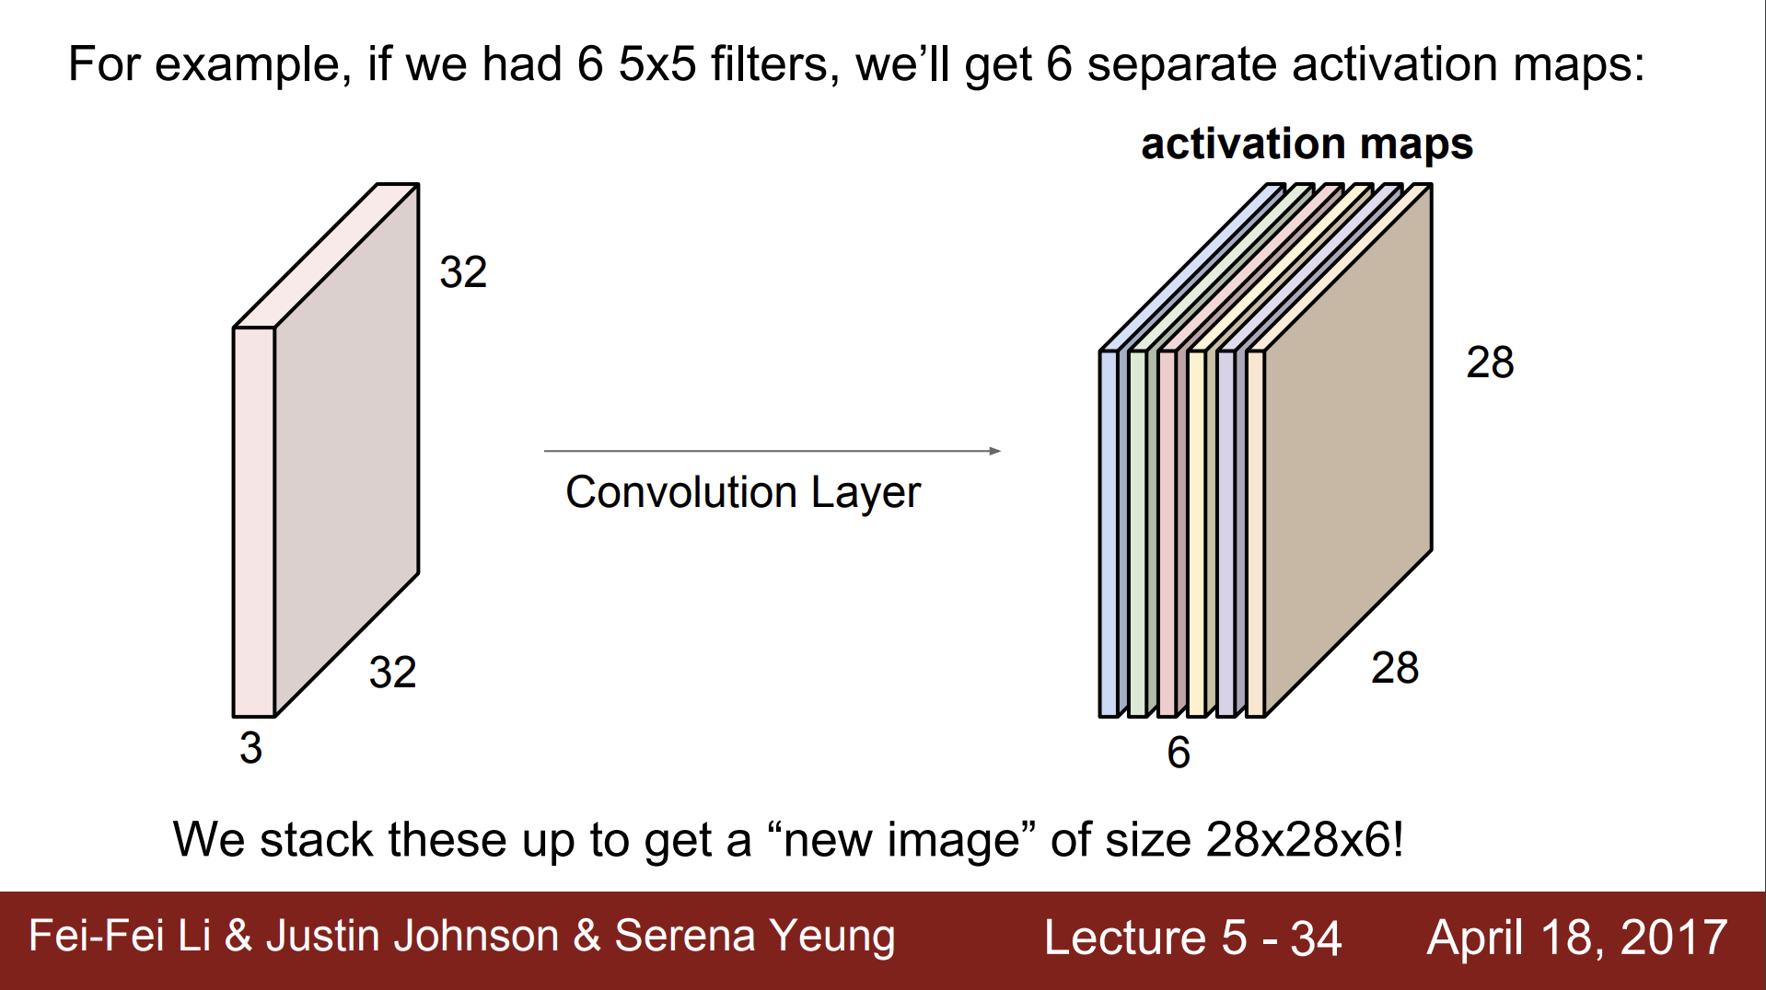

Slide 70
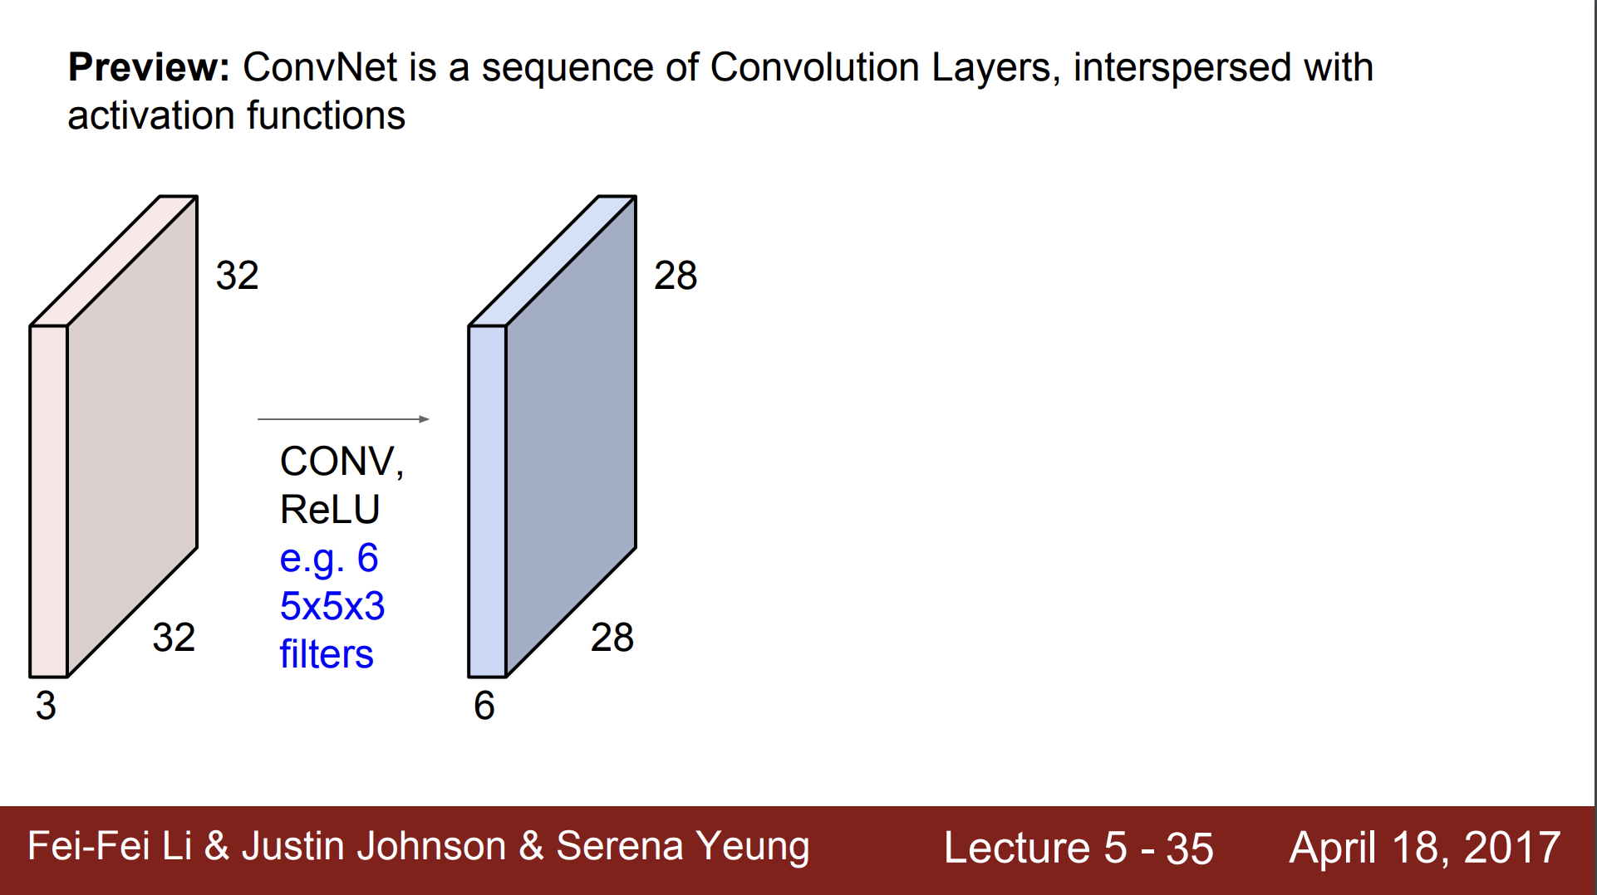

Slide 71
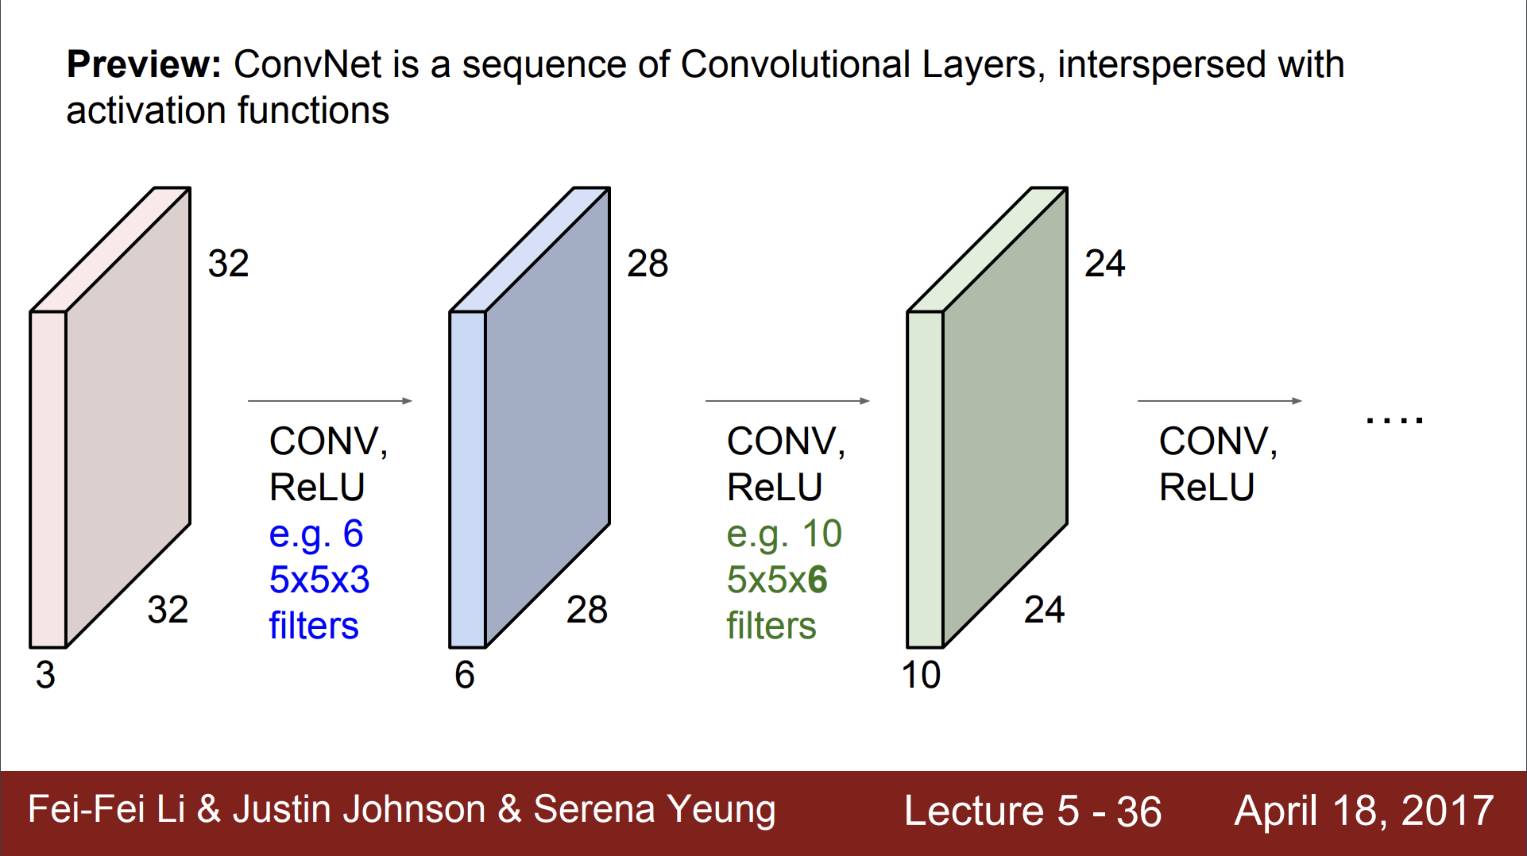

Slide 72
Pooling Layer

Slide 73
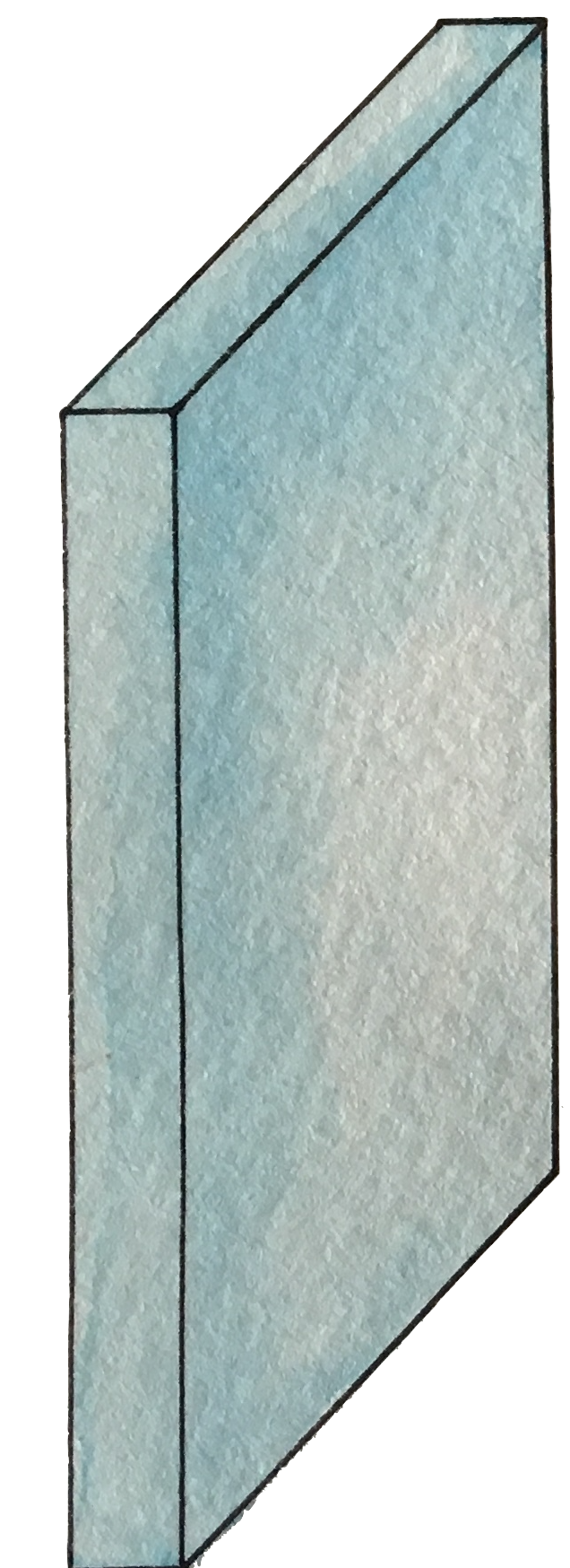
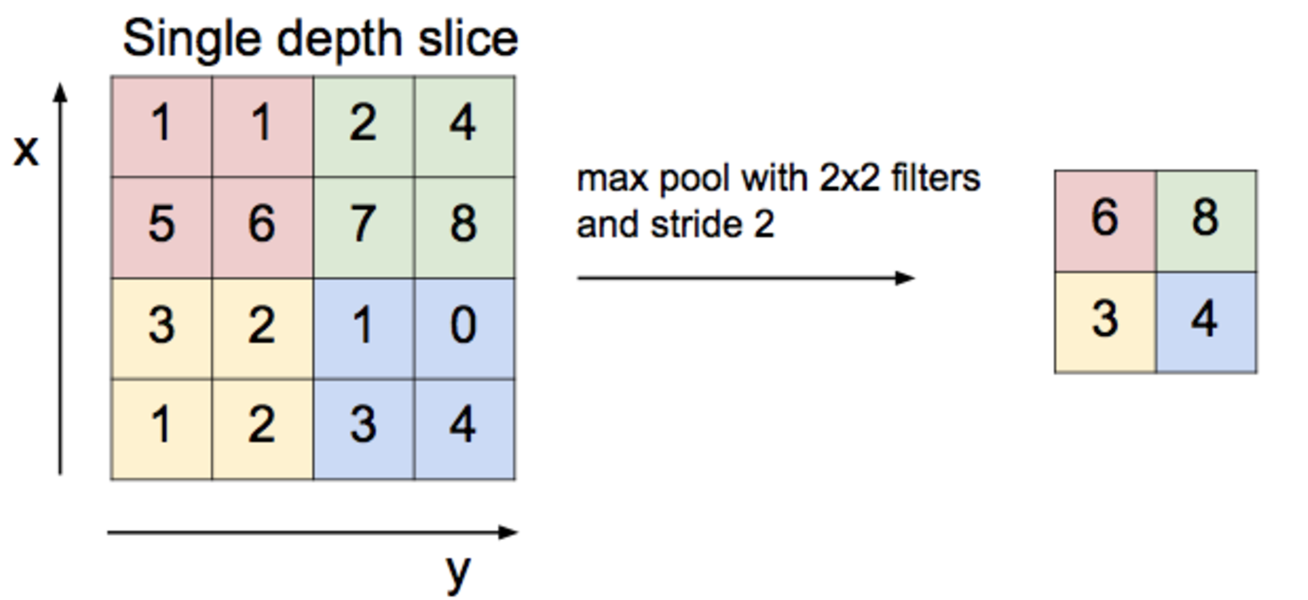
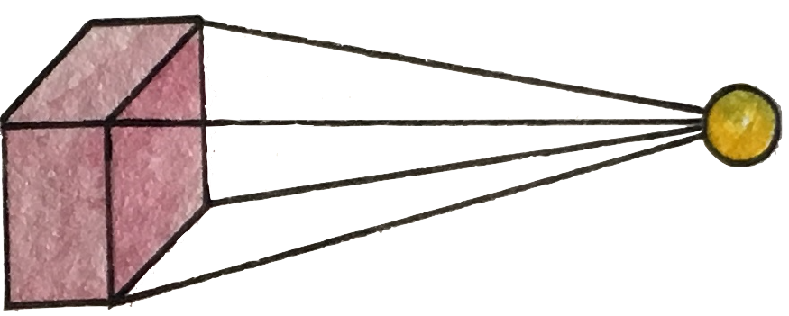
Max pooling

Slide 74
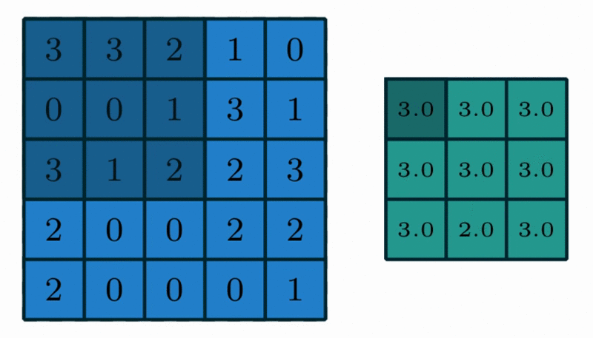
Max Pooling in Action
https://github.com/vdumoulin/conv_arithmetic

Slide 75
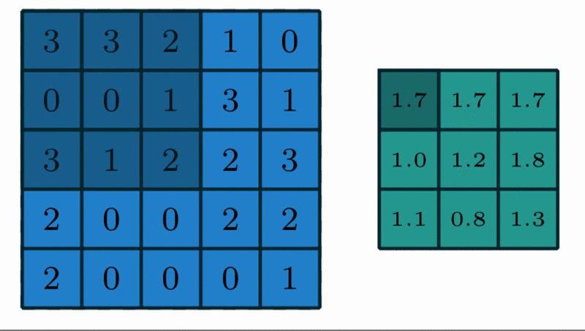
Avg Pooling in Action
https://github.com/vdumoulin/conv_arithmetic

Slide 76
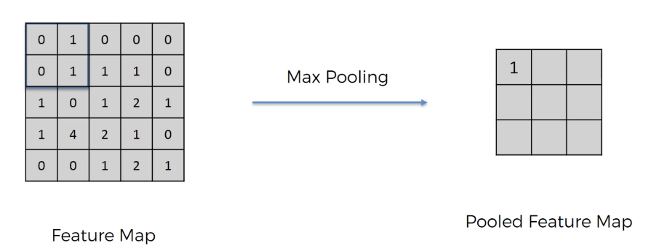
Max Pooling in Action

Slide 77

Max Pooling in Action (with padding)

Slide 78

Max Pooling with depth of 3

Slide 79

Pooling

Slide 80
Reaons of pooling
Makes the input smaller and more manageable
Reduces the number of parameters and computations in the network,
Makes the network invariant to small transformations, distortions and translations in the input image
Small distortion in input will not change the output of Pooling – since we take the maximum / average value in a local neighborhood).
Helps us arrive at an almost scale invariant representation of our image
We can detect objects in an image no matter where they are located.

Slide 81

Fully Connected
https://github.com/vdumoulin/conv_arithmetic

Slide 82
Fully Connected
The Fully Connected layer is a traditional MLP that uses a softmax activation function in the output layer
The purpose of the Fully Connected layer is to use these features for classifying the input image into various classes based on the training dataset
The sum of FC layers’ probability is 1 ensured by Softmax to form a probability distribution.
https://github.com/vdumoulin/conv_arithmetic

Slide 83

實際運算，使用Im2col

Slide 84

CNN

Slide 85


Slide 86

Visualize the CNN

Slide 87


A hand-written digit ‘8’

Slide 88

A hand-written digit ‘8’

Slide 89

A hand-written digit ‘8’

Slide 90


A hand-written digit ‘8’

Slide 91


A hand-written digit ‘8’

Slide 92


Simple CNN

